Slide 1
Successful Treatment of High-Grade Retinoblastoma with Intra-Arterial Chemotherapy
Crystal Cafferty, BA, Medical Student, University of Wisconsin
Eric Monroe, MD, Professor (CHS), University of Wisconsin
Sean Golden, MD, Assistant Professor (CHS), University of Wisconsin

Slide 2
Background
Retinoblastoma is the most common ocular malignancy in pediatric patients. If left untreated, it can invade intraocular structures, metastasize, and rarely lead to death.¹
Mainly diagnosed before the age of 5, it encompasses 10-15% of infant malignancies, with timely treatment ensuring a 97% survival rate.¹
Approximately 90% of cases are sporadic. Hereditary tumors are associated with RB1 gene mutations and account for about 10% of cases.¹
While traditionally treated with systemic chemotherapy, intra-arterial chemotherapy (IAC) is gaining popularity and has been shown to have increased effectiveness and reduced side effects compared to systemic therapy¹

Slide 3
What is the most common presentation of retinoblastoma?
Heterochromia
Orbital cellulitis
Leukocoria
Strabismus

Slide 4
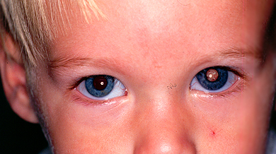
Answer: C – Leukocoria
Leukocoria, also known as white pupillary reflex, is the most common presenting sign of retinoblastoma and is found in 54% of patients. Leukocoria refers to the reflection of white light during illumination of the fundus, rather than the usual red appearance.²
Other common presentations include strabismus (19%), ocular inflammation (5%), and decreased vision (4%). ²
Figure 1. Example of leukocoria associated with a left eye retinoblastoma.²

Slide 5
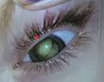
Case Presentation
3yo F presented to the ED with concerns for worsening gait and left sided pupillary changes.
On physical exam, patient was found to have a non-reactive left pupil with heterochromia and leukocoria (Figure 2).
Labs were notable for AFP 192 ng/mL (normal 0-8.8).
MRI head was obtained for further evaluation.
Figure 2. Leukocoria

Slide 6
T1 + contrast
DWI
ADC
Figure 3. MRI demonstrated retinal detachment with associated T1 isointense signal and restricted diffusion.
No significant contrast enhancement or underlying mass was appreciated on initial interpretation.

Slide 7
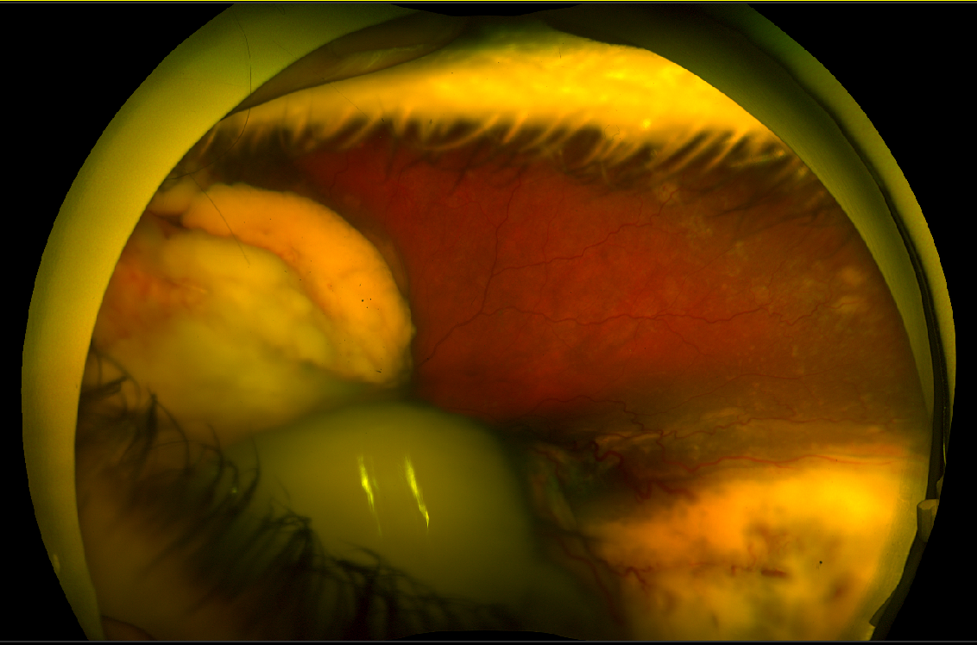
T1 + contrast
DWI
ADC
Figure 4. Fundus exam under anesthesia demonstrated a large white tumor with associated exudative retinal detachment, consistent with an endophytic retinoblastoma (IIRC Group E). Staging evaluations were negative for extraocular metastatic disease.

Slide 8
What would be the International Intraocular Retinoblastoma Classification (IIRC) stage for intraocular retinoblastoma <3mm confined to the retina?
Group A
Group B
Group C
Group D
Group E

Slide 9
Answer: A
The IIRC is the most common classification scheme to stage retinoblastoma confined to the eye.
Classification is typically based on dilated fundoscopy, ocular ultrasound, and optical coherence tomography findings.
All IIRC groups are eligible for IAC therapy, but higher groups are associated with worse outcomes.

Slide 10
IAC Procedure
After multidisciplinary evaluation, the patient was referred to IR for IAC with goals of tumor control and vision salvage.
Following induction of general anesthesia, ¼-inch of 2% nitroglycerin transdermal cream was applied to the chest for prophylaxis of intracranial arterial vasospasm.
Right common femoral access was obtained with 4 Fr low-profile sheath.
The left ICA was selected with a 4 Fr vertebral catheter. Angiography of the left ICA demonstrated orthotopic origin of the left ophthalmic artery.
ADC
Figure 5. Lateral left ICA digital subtraction angiography demonstrates normal origin of the left ophthalmic artery.

Slide 11
IAC Procedure
The left ophthalmic artery was subselected with a 1.5 Fr Marathon microcatheter and 0.008” Asahi Chikai wire.
Left ophthalmic arteriogram demonstrated antegrade flow to the central retinal artery (Fig. 6, arrow) and choroid (Fig. 6, arrowhead). After administration of 1 mg intra-arterial verapamil, intra-arterial chemotherapy (topotecan, carboplatin, melphalan) was safely administered.
ADC
Figure 6

Slide 12
In a patient undergoing IAC for retinoblastoma, the internal carotid artery provides dominant supply to the ophthalmic artery. However, the Interventional Radiologist is unable to catheterize the ophthalmic artery from the ICA due a steep, downward angle of the ophthalmic artery ostium. In cases like this, which artery can be catheterized to provide an alternative access route to catheterize the ophthalmic artery?
External carotid artery
Anterior cerebral artery
Inferior thyroidal artery
Posterior communicating artery

Slide 13
Answer: D
The ipsilateral posterior communicating artery can provide an alternative access approach to facilitate catheterization of the ophthalmic artery, particularly in patients with steep and down-going ophthalmic artery ostia.

Slide 14
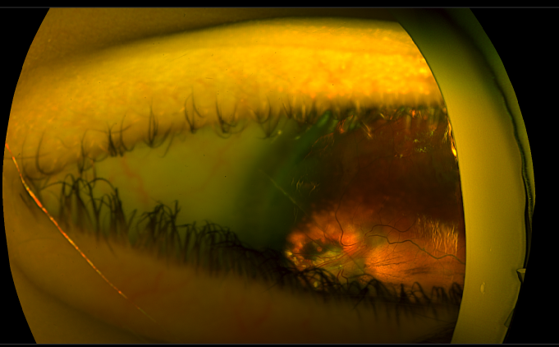
Follow-up
The patient underwent eight cycles of IAC with good treatment response and no evidence of recurrence after two years of follow up.
Interestingly, patient’s heterochromia resolved after IAC (Figure 7). Heterochromia is seen in 1% of retinoblastoma patients and can be caused by iris neovascularization.
Repeat fundoscopic exams showed calcific regression of tumor with stable retinal detachment (Figure 8). Follow up MRIs showed substantial decrease in size of tumor (Figure 9).
ADC
Figure 7. Heterochromia of left eye with subsequent resolution
Figure 8. Follow up fundoscopic exam
Figure 9. Follow up MRI (T1 post contrast)

Slide 15
Discussion
Intra-arterial chemotherapy (IAC) is becoming a mainstay in retinoblastoma therapy due to improved patient outcomes and avoiding systemic effects of IV chemo.
While single drug chemotherapy regimens have been trialed, triple IAC combinations of topotecan, carboplatin, and melphalan are generally preferred due to improved tumor response with minimal additional toxicity.¹
Three sessions of IAC is most common, but eight or more sessions can be performed.
Traditionally reserved for unilateral localized disease, IAC has expanded to include treatment of bilateral disease as tandem therapy.¹
Contraindications include systemic metastasis, trilateral retinoblastoma, extensive optic nerve or scleral involvement, orbital extension, glaucoma, active ocular infection, hyphema, vitreous hemorrhage, and prephthisical eye.¹

Slide 16
References
Kolyvas P, Mir A, Stirrat T, Brookner B, Pilar N, Monroe E, Ahuja R. Advanced Interventional Treatments in Retinoblastoma Management: A Comprehensive Review. Cardiovasc Intervent Radiol. 2024 Apr;47(4):407-415. doi: 10.1007/s00270-024-03692-2. Epub 2024 Mar 20. PMID: 38509339.
Berry, J. MD, (May 2025). Retinoblastoma: Clinical Presentation, evaluation, and diagnosis. UpToDate, Retrieved 6/21/23025, https://www-uptodate-com.ezproxy.library.wisc.edu/contents/retinoblastoma-clinical-presentation-evaluation-and-diagnosis?search=IIRC%20retinoblastoma&source=search_result&selectedTitle=2~67&usage_type=default&display_rank=2#H14

